Slide 1
Exception Handling

Slide 2
CONTENTS
Try
Throw
Catch
Throwing an Exception
Catching an Exception.

Slide 3
Exception
Indication of problem that occurs during a program’s execution, example, an attempt to divide by zero, new operator fails to allocate memory for an object.
Exception handling provides the standard mechanism for processing errors.
It allows the programmer to continue executing as if no problem had been encountered.

Slide 4
Exception Handling Advantages
It helps the programmer to write robust and fault-tolerant programs that can deal with problems continue executing or terminate gracefully.
Exception handling also is useful for processing problems that occur when a program interacts with software elements, such as member functions, constructors, destructors and classes.

Slide 5
Exception Handling Mechanism
Find the problem (Hit the exception).
Inform that error has occurred (throw the exception).
Receive the error information (catch the exception).
Take corrective actions (handle the exception).

Slide 6
Cont…
Error handling code basically consists of two parts.
  Detect error and throw the exception (in try block)
  Catch exception and take appropriate action. (in catch block)

Slide 7
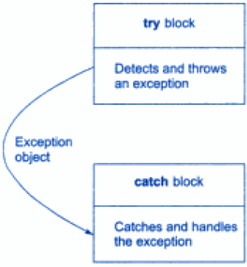
Cont..
Exception handling basically has 3 keywords:
Try
Throw
Catch

Slide 8
Cont..
In try block, we add those block of statements which may generate exceptions. When an exception is detected, it is thrown using a throw statement in a try block.
A catch block defined by keyword catch ‘catches’ the exception ‘thrown’ by throw statement in the try block and handles it appropriately.

Slide 9
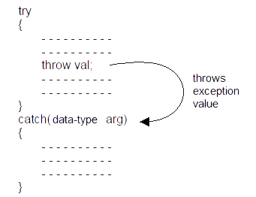
Cont..
The catch block that catches an exception must immediately follows the try block that throws the exception.

Slide 10
Throw and Catch
The throw statement is almost similar to function call. The only difference is that instead of calling the function, it calls the catch block.
In this sense, the catch block is like function definition with a parameter that matches the type of value being thrown.

Slide 11
Throw
The throw expression accepts one parameter as its argument and this is passed to the exception handler.
You can have a number of throw statements at different parts of your try block with different values being thrown so that the exception handler on receiving the parameter will know what restorative actions to take.

Slide 12
Catch
The exception handler can be identified by the keyword catch .
catch always takes only one parameter.
The type of the catch parameter is important as the type of the argument passed by the throw expression is checked against it and the catch function with the correct parameter type is executed.
This way we can chain multiple exception handlers and only the one with the correct parameter type gets executed.

Slide 13
Cont..
try { // code here }
catch (int param) {
cout << "int exception";
}
catch (char param) {
cout << "char exception";
}
catch (...) {
cout << "default exception";
}
try
{ // code
if ( x )
throw 10;
// code
if (y)
throw 20;
//code
}

Slide 14
Throwing an exception in a Function

Slide 15
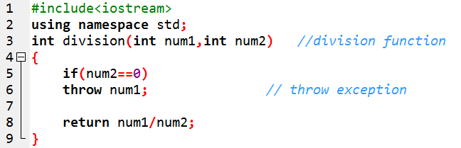
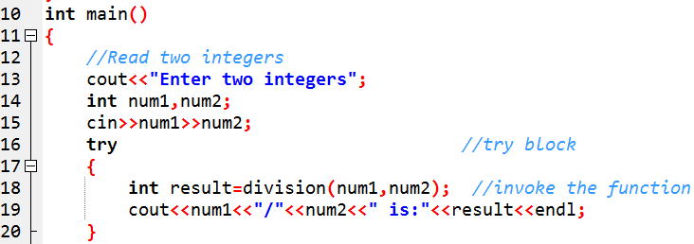
Throwing an Exception in a Function

Slide 16
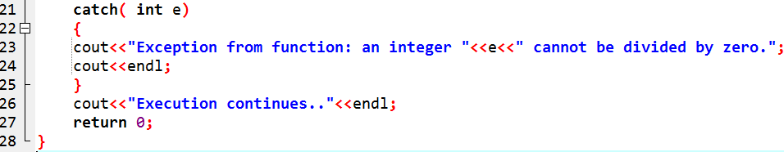
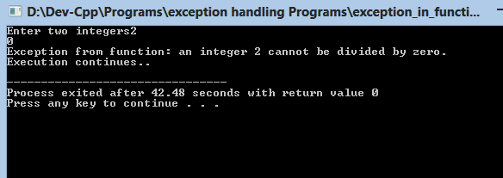
Cont..

Slide 17
Re-throwing an Exception
It’s possible that an exception handler, upon receiving an exception, might decide either that it cannot process that exception or that it can process the exception only partially.
In such cases, the exception handler can defer the exception handling (or perhaps a portion of it) to another exception handler.

Slide 18
Cont..
In either case, you achieve this by re throwing the exception via the statement
throw;
Regardless of whether a handler can process an exception, the handler can re throw the exception for further processing outside the handler.

Slide 19
Cont..
#include <iostream>
#include <exception>
using namespace std;
void func1()
{
// throw exception and catch it immediately
try
{
cout << "\n This function throws an exception\n";
throw exception(); //generate exception
} // end try

Slide 20
Cont..
catch(exception &)
{
cout << " exception is catched in 1st catch block"
<< "\n Function func1 re throws exception";
throw; //rethrow exception for further processing
} // end catch
cout << "This also should not print\n";
} // end of func1

Slide 21
Cont..
int main()
{
try
{
cout << "\n main invokes function func1\n";
func1();
cout << "This should not print\n";
} // end try
catch (exception e) // handle exception
{
cout << "\n\n Exception handled in main\n";
} // end catch
cout << " Program control continues after catch in main\n";
} // end main

Slide 22
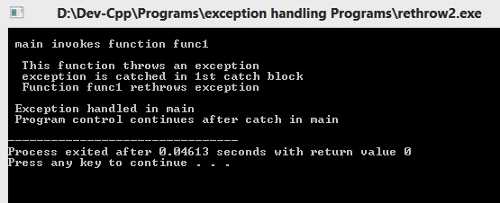
Cont..

