Slide 1
Unit 3 Inheritance
One of the most important concepts in object-oriented programming is that of inheritance.
Inheritance allows us to define a class in terms of another class, which makes it easier to create and maintain an application.
This also provides an opportunity to reuse the code functionality and fast implementation time.
When creating a class, instead of writing completely new data members and member functions, the programmer can designate that the new class should inherit the members of an existing class.
This existing class is called the base class, and the new class is referred to as the derived class.
The idea of inheritance implements the is a relationship. For example, mammal IS-A animal, dog IS-A mammal hence dog IS-A animal as well and so on.

Slide 2
Base & Derived Classes:
A class can be derived from more than one classes, which means it can inherit data and functions from multiple base classes. To define a derived class, we use a class derivation list to specify the base class(es). A class derivation list names one or more base classes and has the form:
class derived-class: access-specifier base-class
Where access-specifier is one of public, protected, or private, and base-class is the name of a previously defined class. If the access-specifier is not used, then it is private by default.

Slide 3
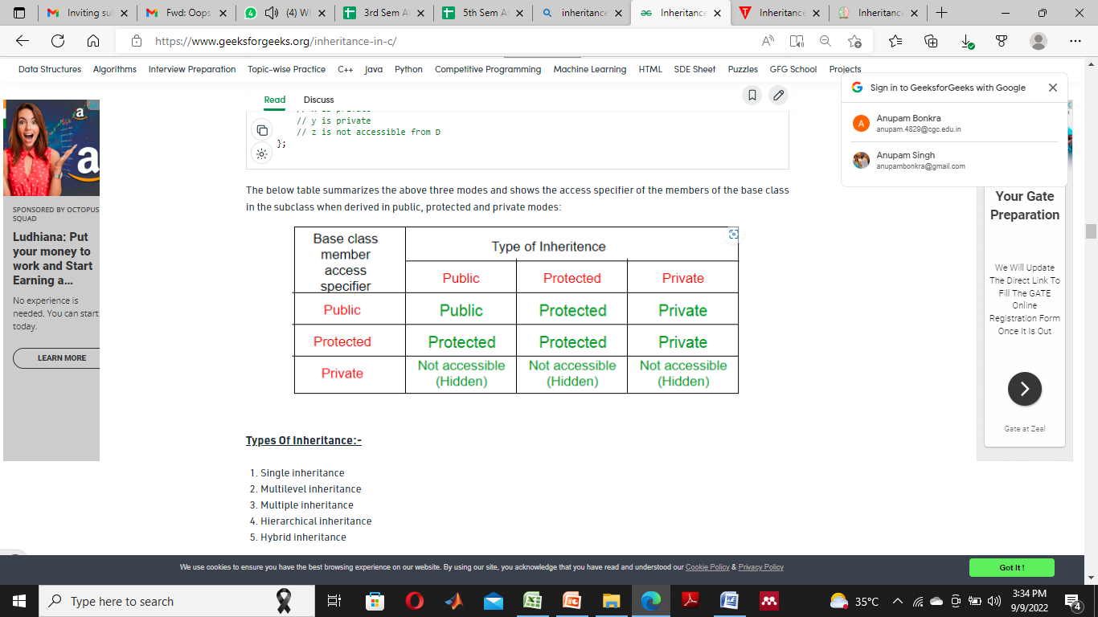

Slide 4
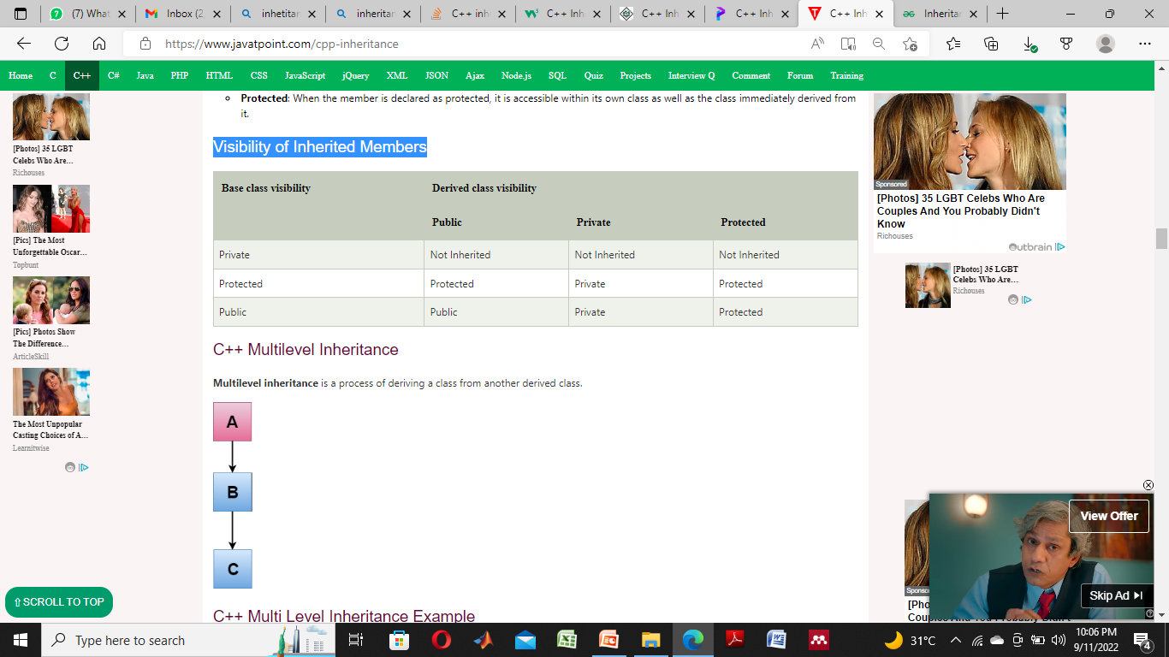
Visibility of Inherited Members

Slide 5
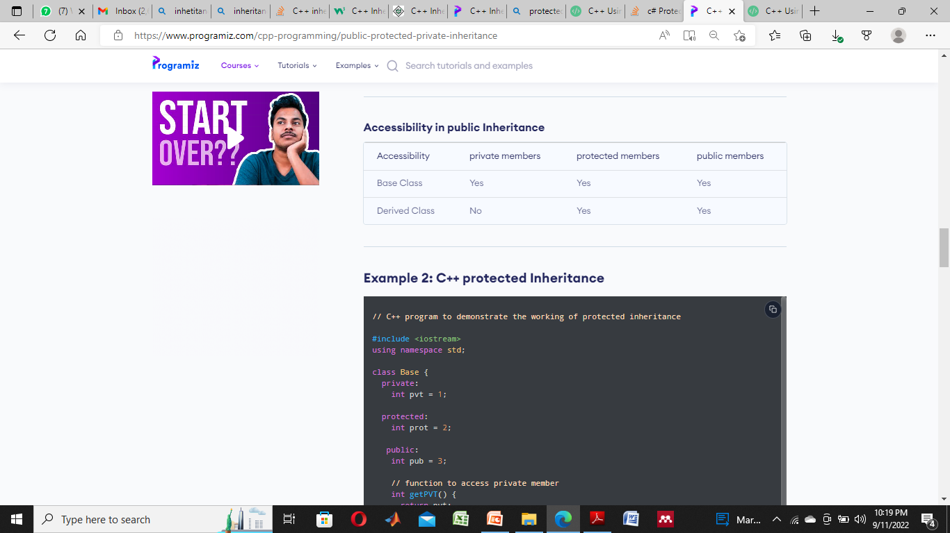

Slide 6


Slide 7


Slide 8
Type of Inheritance:
Single Inheritance
Multiple Inheritance
Multilevel Inheritance
Hybrid Inheritance
Hierarchical Inheritance

Slide 9
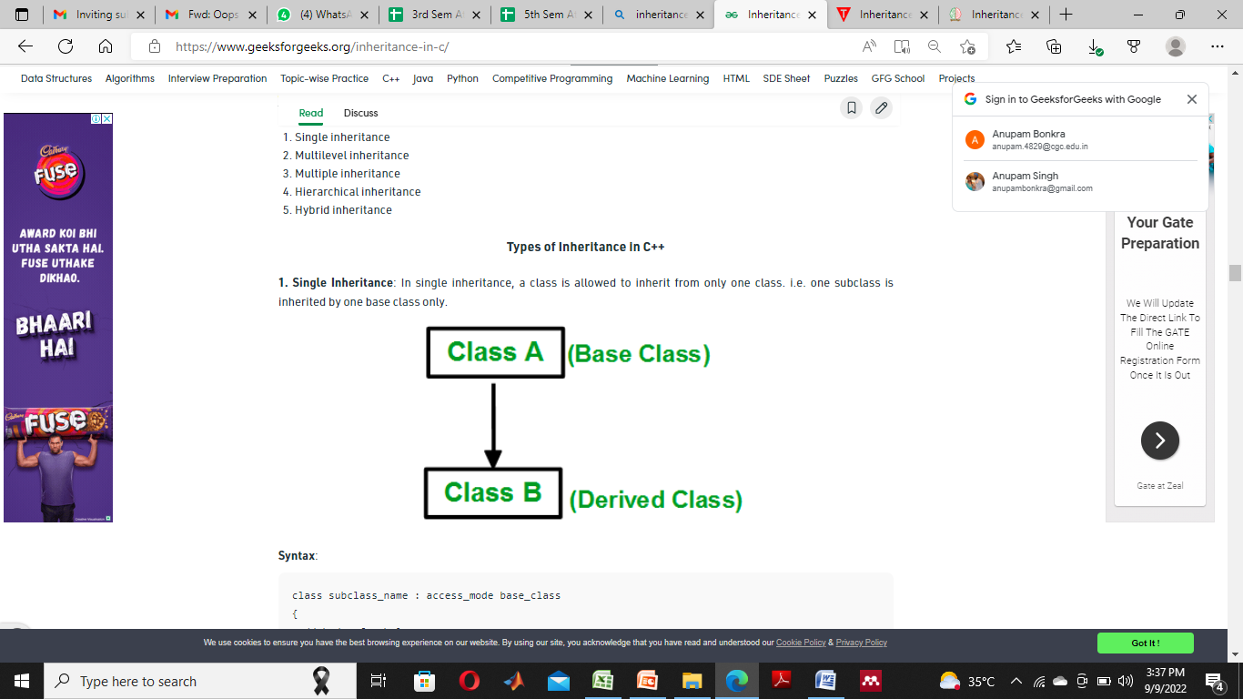
1. Single Inheritance:
In single inheritance, a class is allowed to inherit from only one class. i.e. one subclass is inherited by one base class only.

Slide 10
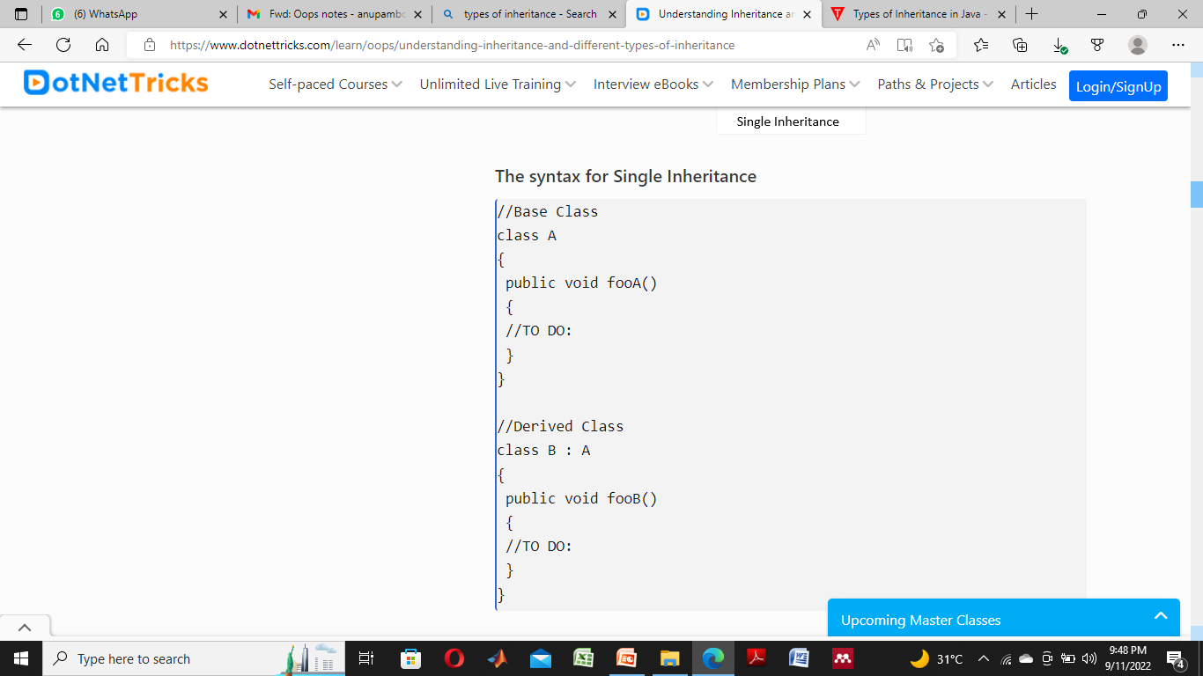

Slide 11
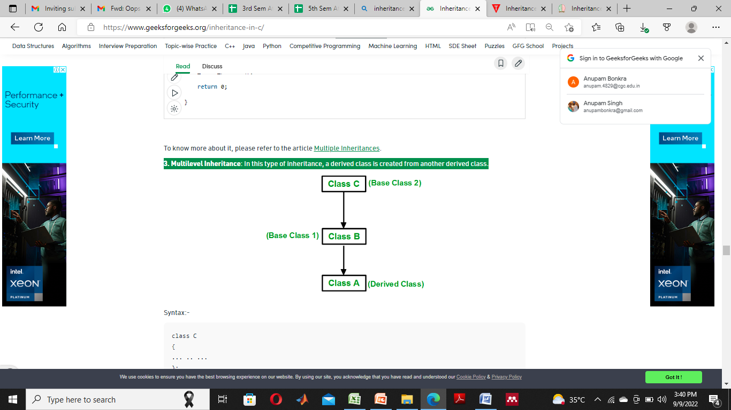
2. Multilevel Inheritance
In this type of inheritance, a derived class is created from another derived class.

Slide 12
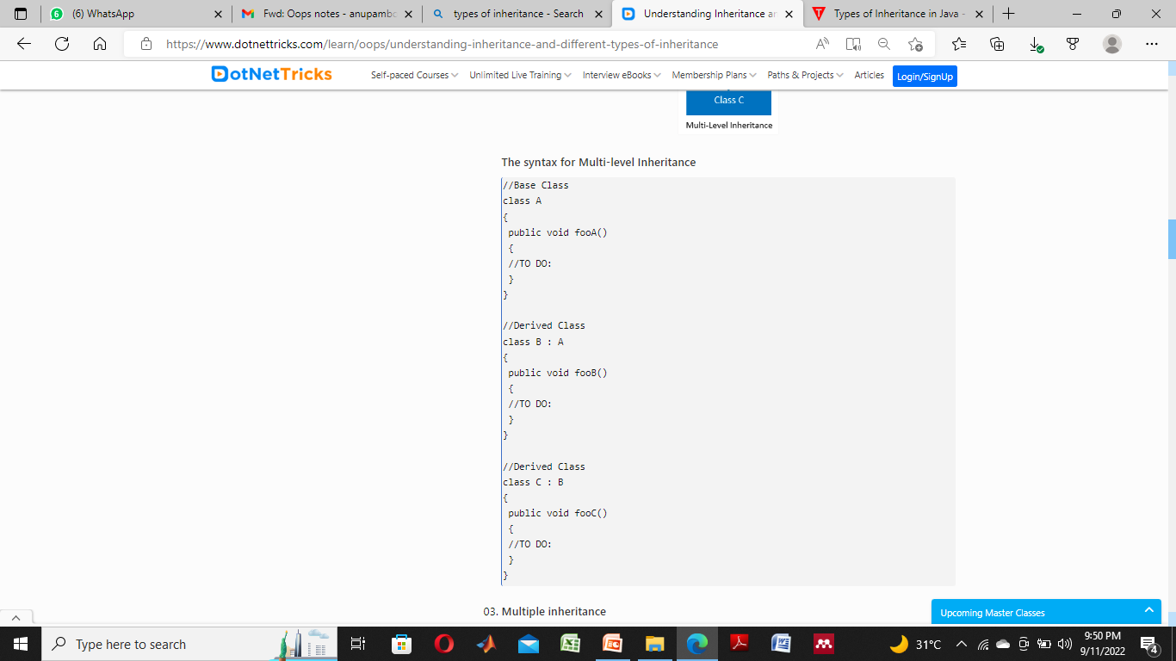

Slide 13
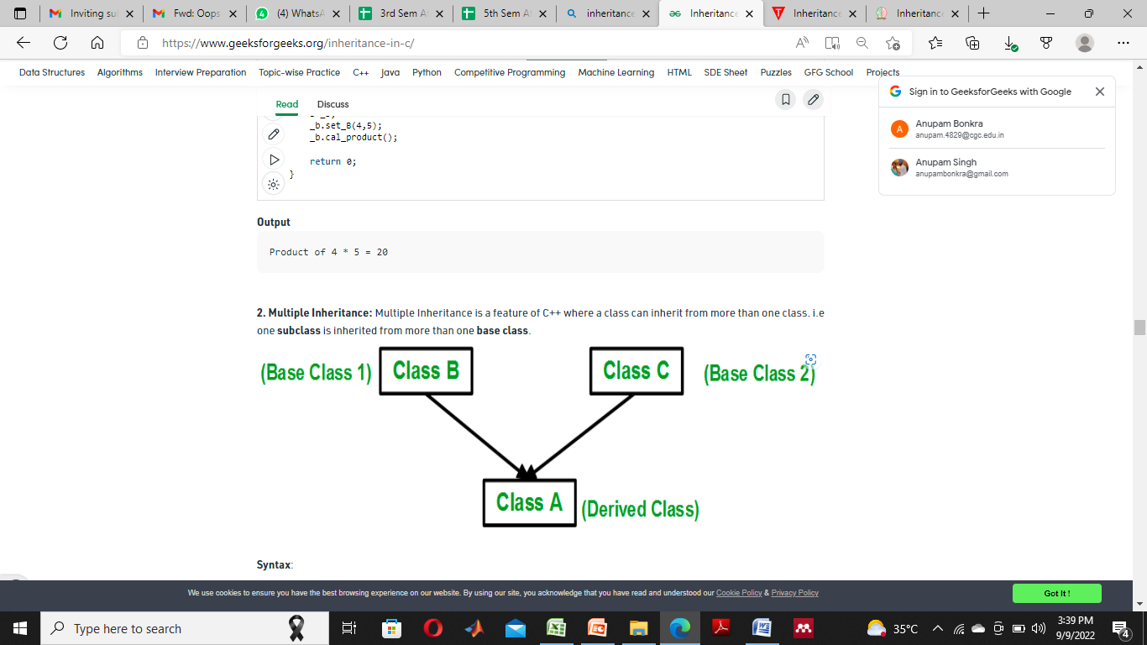
3. Multiple Inheritance:
Multiple Inheritance is a feature of C++ where a class can inherit from more than one class. i.e one subclass is inherited from more than one base class.

Slide 14
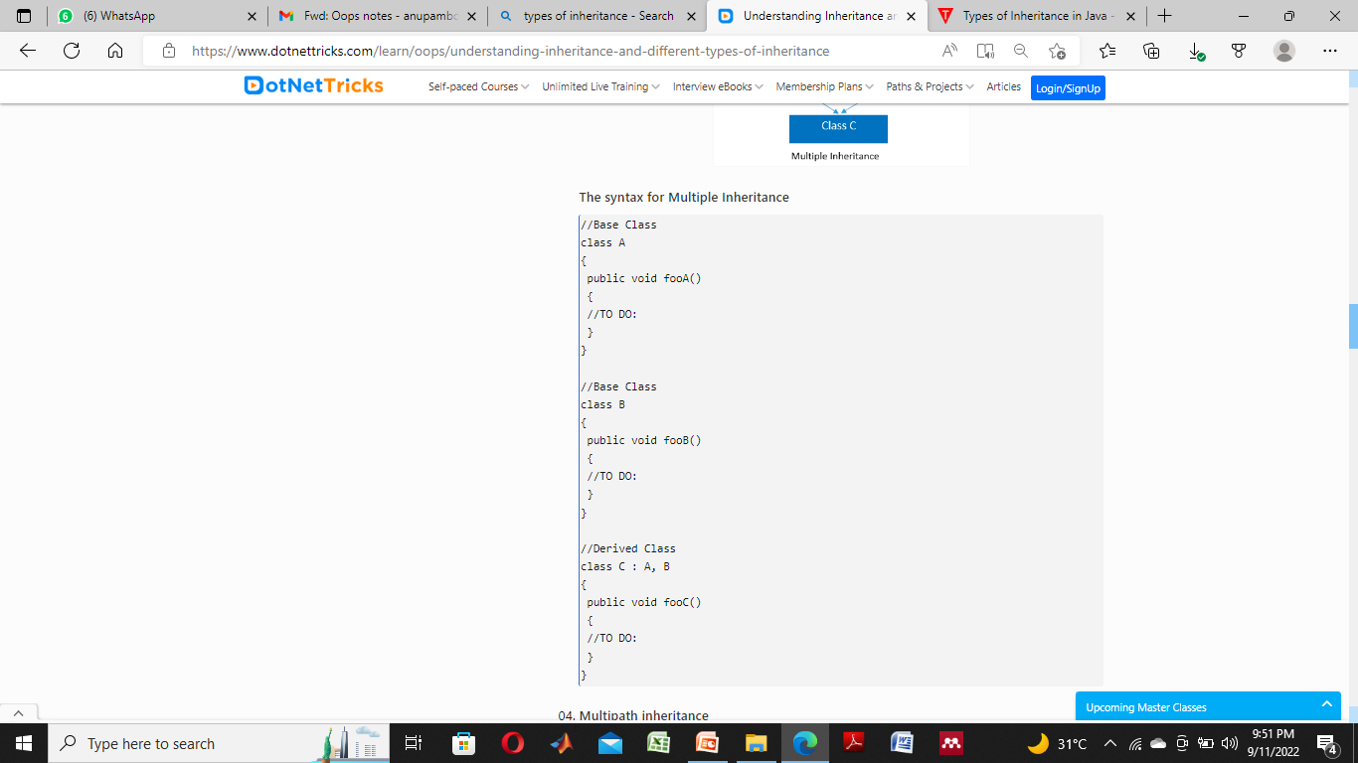

Slide 15
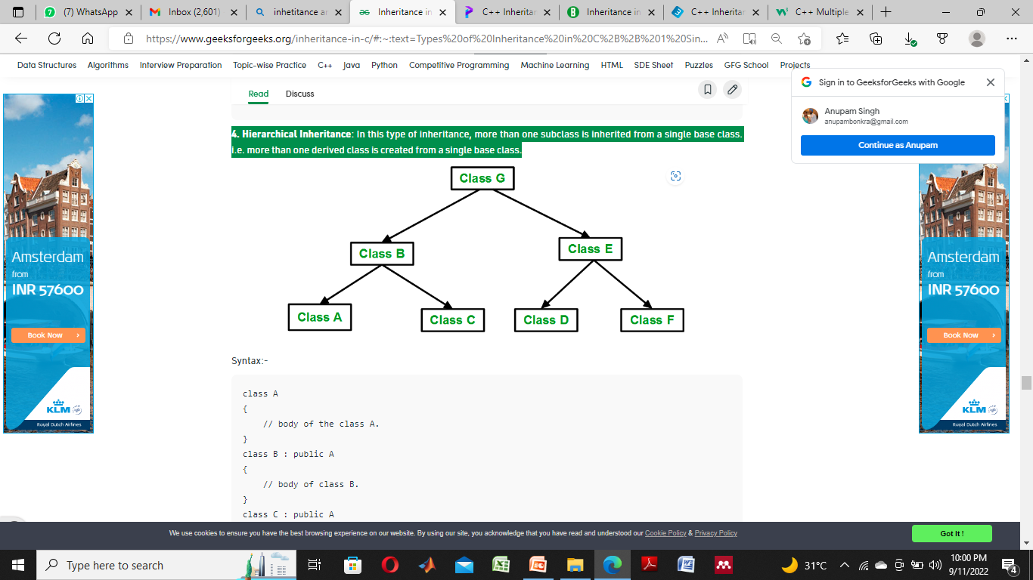
4. Hierarchical Inheritance:
In this type of inheritance, more than one subclass is inherited from a single base class. i.e. more than one derived class is created from a single base class.

Slide 16
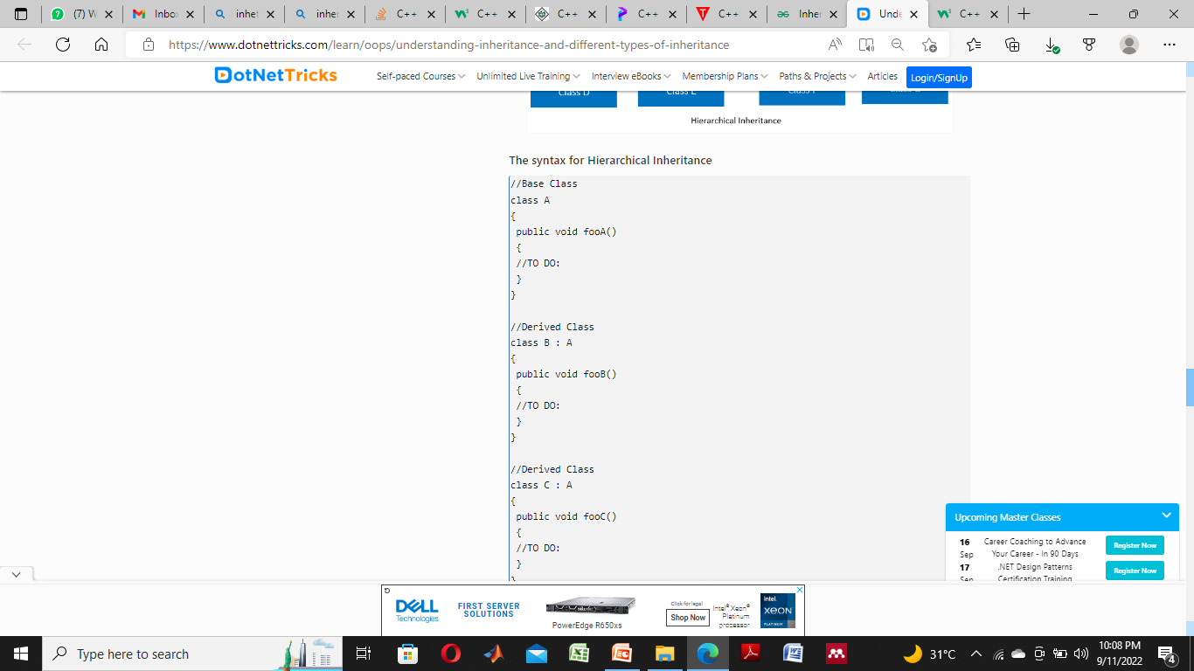

Slide 17
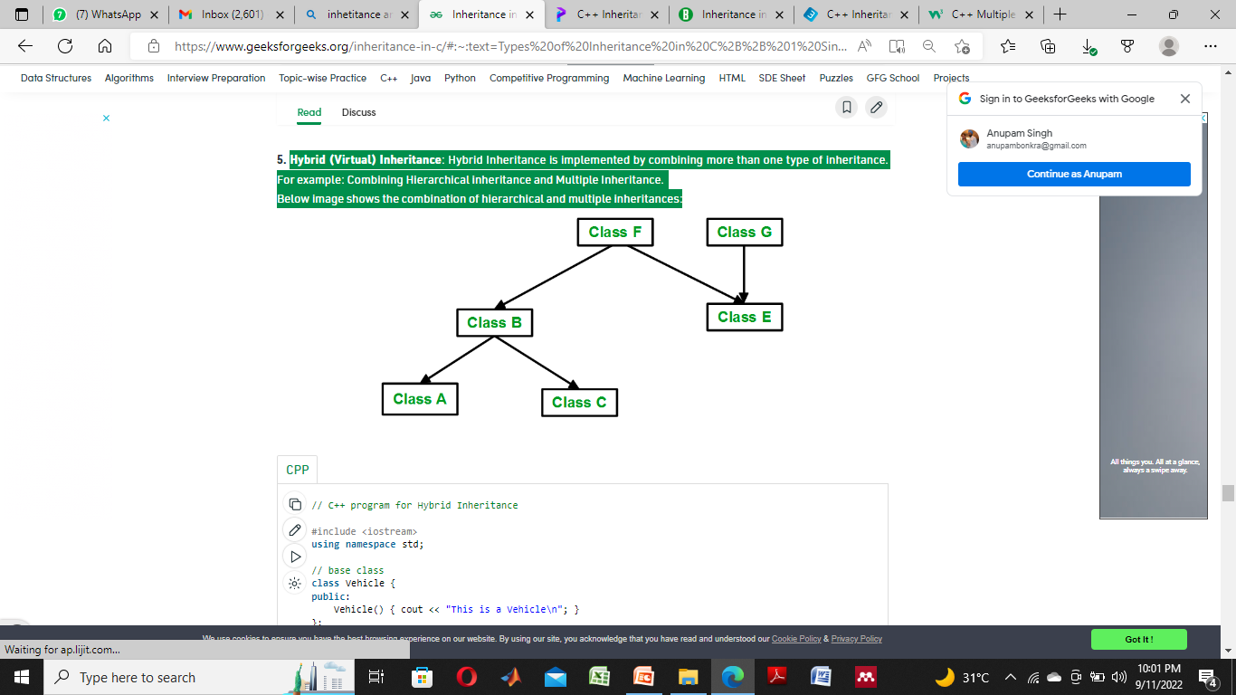
Hybrid (Virtual) Inheritance:
Hybrid Inheritance is implemented by combining more than one type of inheritance.
For example: Combining Hierarchical inheritance and Multiple Inheritance. Below image shows the combination of hierarchical and multiple inheritances:

Slide 18
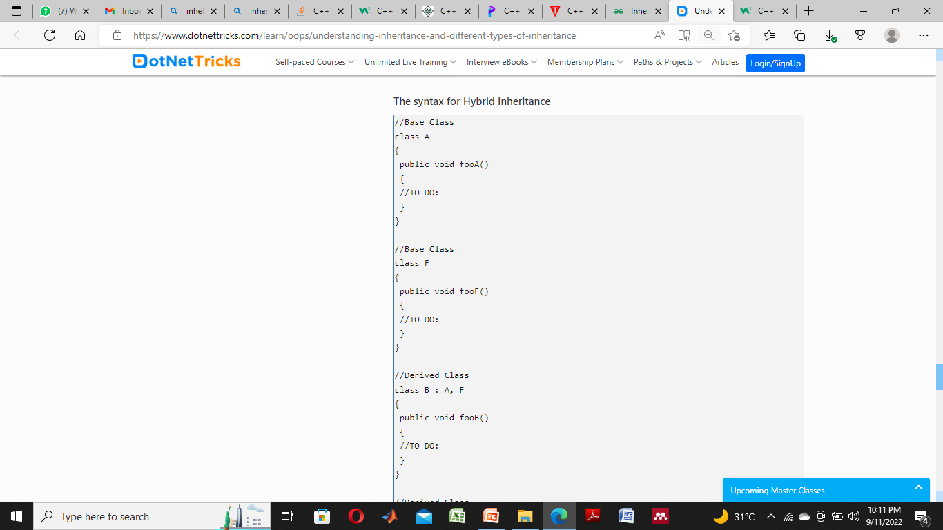

Slide 19
C++ Using protected Members in inheritance
The protected keyword is included in C++ to provide greater flexibility for the inheritance mechanism.
When a member of a class is declared as protected, that member is not accessible to other, non-member elements of the program.
With one important exception, access to a protected member is the same as access to a private member; it can be accessed only by other members of the class of which it is a part.

Slide 20
A private member of a base class is not accessible by any other part of your program, including any derived class.
When a base class is inherited as public, protected members in the base class become protected members of the derived class, and are accessible to the derived class.
Therefore, by using protected, you can create class members that are private to their class, but that can still be inherited and accessed by a derived class.

Slide 21
